Slide 1

Money and Business Cycles II:
Sticky Prices and
Nominal Wage Rates

Slide 2
The New Keynesian Model

Slide 3
The New Keynesian Model
凯恩斯主义：（也称“凯恩斯主义经济学”）是建立在凯恩斯著作《就业、利息和货币通论》的思想基础上的经济理论。主张国家采用扩张性的经济政策，通过增加总需求促进经济增长，即扩大政府开支，实行赤字财政，刺激经济，维持繁荣。
新凯恩斯主义：是指20世纪70年代以后在凯恩斯主义基础上，吸取非凯恩斯主义某些观点与方法形成的理论，其中一点就是货币非中性。

Slide 4
The New Keynesian Model
Sticky prices（价格粘性）：nominal goods prices that do not react rapidly to changed circumstances.
Sticky price relies on 2 main ingredients.
  the typical producer actively sets the price of the good that he or she sells in the market.
  when choosing the price to set, each producer takes into account a cost of changing prices. This cost is sometimes called a menu cost.

Slide 5
The New Keynesian Model
Price Setting Under Imperfect Competition
  How a producer in an environment of imperfect competition chooses the price of his or her goods? （不完全竞争：至少有一个大到足以影响市场价格的买者（或卖者），并因此面对向下倾斜的需求（或向上倾斜的供给）曲线）
    Let P( j ) be the price charged for a good by firm j.
    The quantity demanded of firm j ’s goods is Y^{d}(j)

Slide 6
The New Keynesian Model
  We can get the main results by assuming the customers of firm j compare the price, P(j), with the average of the prices charged by other firms.
  If we let this average price be P, then Y^{d}(j) depends on the price ratio, P(j)/P. An increase in P(j)/P lowers Y^{d}(j), and a decrease in P(j)/P raises Y^{d}(j).

Slide 7
The New Keynesian Model
  The quantity of goods demanded at firm j, Y^{d}(j), depends also on the incomes of persons who are current or potential customers of the firm.
  If the real income in the whole economy increases, the demand, Y^{d}(j), will rise for each P(j).

Slide 8
The New Keynesian Model
  The production function for firm j looks like the function we have used before:
    Y(j) = F[κ(j) · K(j) , L(j) ]
  The nominal wage rate, w, is the same for labor used by all the firms in the economy.
  Firm j has a MPL
    MPL(j) = ∆Y(j)/ ∆L(j)
  Firm j nominal marginal (labor) cost
  w/MPL(j)

Slide 9
The New Keynesian Model
  under imperfect competition, each firm can set P(j) above its nominal marginal cost. The ratio of P(j) to the nominal marginal cost is called the markup ratio （加成比例）
  firm j markup ratio
  = P(j)/(firm j nominal marginal cost)
= P(j)/[w/MPL(j)],
  then: P(j)=( markup ratio) · [w/MPL(j) ]

Slide 10
The New Keynesian Model
  With imperfect competition, the profit-maximizing decisions of firms determine a distribution of the P(j).
  Each firm demands labor, and the total of these demands determines the economy wide labor demand, L^{d}.
  The equilibrium of the economy-wide labor market equates the aggregate quantity of labor demanded, L^{d}, to the aggregate quantity supplied, L^{s}.

Slide 11
The New Keynesian Model
Short-Run Responses to a Monetary Shock
  Imagine the nominal quantity of money, M, doubles.
    IF without price stickiness, each nominal price, P(j), doubles when M doubles; the average price, P, doubles; the economy-wide nominal wage rate, w, also doubles as before.
    These changes leave unchanged the real variables in the economy.
    The real variables include the economy-wide real wage rate, w/P, also the ratio of each firm’s price to the average price, P(j)/P.

Slide 12
The New Keynesian Model
  The effects of price stickiness. We can consider the extreme case in which all of the P(j) are sticky in the short run.
    The average price, P, would also be fixed. If P is constant and the nominal quantity of money, M, doubles, each household would have twice as much real money, M/P, as before.
    However, nothing has changed to motivate households to hold more money in real terms. Each household would therefore spend its excess money, partly by buying the goods produced by the various firms.
    Each firm j would then experience an increase in the quantity demanded of its goods, Y^{d}(j).

Slide 13
The New Keynesian Model
  If P(j) is fixed, a profit-maximizing firm would—over some range—meet an increase in demand by raising production, Y(j).
    To raise its production, Y(j), firm j has to increase its quantity of labor input, L(j).
  With a fixed price P(j) , an increase in the nominal quantity of money, M, leads to an expansion of labor demand by each firm j .

Slide 14
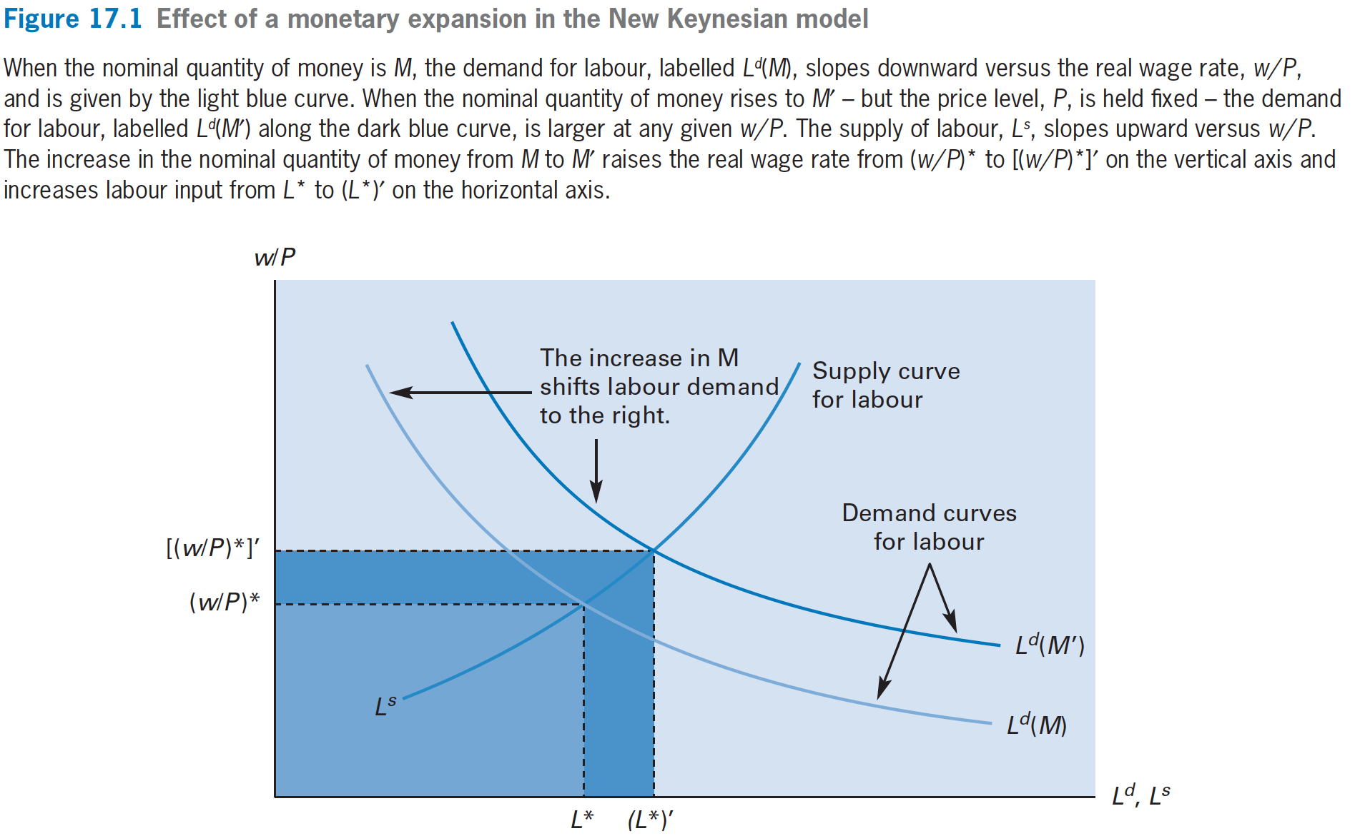
The New Keynesian Model

Slide 15
The New Keynesian Model
Short-Run Responses to a Monetary Shock
  An increase in the nominal quantity of money from M to M’ raises the market-clearing labor input from L∗ to (L∗)’ on the horizontal axis.
  With the increase in labor input, each firm produces more goods Thus, real gross domestic product (GDP), Y, increases.

Slide 16
The New Keynesian Model
  We therefore have that a monetary expansion is non-neutral. An increase in the nominal quantity of money raises real GDP.
  Moreover, labor input, L, moves in a pro-cyclical manner—it rises along with Y.

Slide 17
The New Keynesian Model
New Keynesian Predictions
  The predictions from the new Keynesian model are similar to those from the price-misperception model.
    That model also gave the result that a monetary expansion raised real GDP, Y, and labor input, L.

Slide 18
The New Keynesian Model
  One difference between the two models concerns the real wage rate, w/P.
    The price-misperception model, an expansion of L had to be accompanied by a fall in w/P in order to induce employers to use more labor input. This model predicted—counterfactually—that w/P would be countercyclical.
    This sticky price model, a monetary expansion increases the market-clearing real wage rate from (w/P)∗ to [(w/P)∗]’ on the vertical axis. Therefore, the model generates a pro-cyclical pattern for w/P.

Slide 19
The New Keynesian Model
Price Adjustment in the Long Run
  In the longer run, the prices adjust, and these adjustments tend to undo the real effects from a change in the nominal quantity of money, M.
  Our conclusion is that the real effect of a monetary shock in the new Keynesian model is a short-run result that applies only as long as prices fail to adjust to their equilibrium levels.

Slide 20
The New Keynesian Model
  Data do reveal stickiness of some prices; that is, prices for some types of products often do not change for several months.
  However, a tentative conclusion from empirical research with these new data is that, price stickiness is insufficient to explain a major part of economic fluctuations.

Slide 21
The New Keynesian Model
Comparing Predictions for Economic Fluctuations
  The new Keynesian model correctly predicts a pro-cyclical pattern for real wage rate, w/P, and a countercyclical pattern for price level, P.

Slide 22
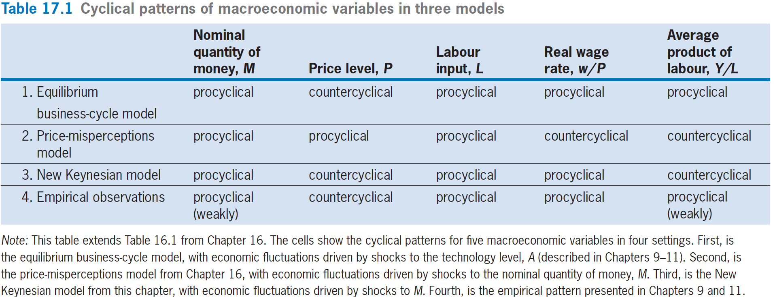
The New Keynesian Model

Slide 23
The New Keynesian Model
Shocks to Aggregate Demand
  Each firm j might experience an increase in the demand for its goods, Y^{d}(j), while its price, P(j), was held fixed.
  The same results apply if Y^{d} (j) rises for each firm j for reasons having nothing to do with money. The essential ingredient is an positive shock to the aggregate demand for goods.

Slide 24
The New Keynesian Model
  One way for aggregate demand to rise is for households to shift exogenously away from current saving, and toward current consumption, C.
  Another possibility is that the government could boost the aggregate demand for goods by increasing its real purchases, G.
  Immigrants matter as well.

Slide 25
The New Keynesian Model
  The new Keynesian model has the property that an increase in the AD for goods may end up increasing real GDP, Y, by even more than the initial expansion of demand.
  That is, there may be a multiplier in the model: rise in Y may be a multiple greater than one of the rise in demand. Because the expansion of Y leads to increases in real income (w/P)*L. This extra income motivates further increase in production goods.
  This Keynesian multiplier is only a theoretical result, which has not been verified empirically.

Slide 26
Money and Nominal Interest Rates

Slide 27
Money and Nominal Interest Rates
In practice, the central banks tend to express monetary policy as targets for short-term nominal interest rates i, rather than monetary supply M.
Eg: in the UK, especially since the early 1980’s, the Bank of England focuses on the official bank rate: the overnight nominal interest rate at which the Bank of England lends to commercial banks.

Slide 28
Money and Nominal Interest Rates
The Bank of England’s Monetary Policy Committee (MPC) meets 12 times per year.
At each meeting, the MPC adopts a target for the official bank rate.
The idea is that, in the short run with sticky prices, open-market operations affect nominal interest rates, that is, the official bank rate in UK and the nominal interest rate, i, in our model.

Slide 29
Money and Nominal Interest Rates
M= P·L(Y,i), the determinants of the nominal quantity of money demanded: the price level, P; real GDP, Y; and the nominal interest rate, i.
In new Keynesian model, P is fixed in the short run. Thus, in the short run, if M increases, equilibrium requires some combination of higher Y or lower i to raise the nominal quantity of money demanded by the same amount.
For given Y, a higher M has to match up with a lower i.（这个和我们在宏观经济学原理学到的结论是一致的）

Slide 30
Money and Nominal Interest Rates
In our previous analysis, we thought of an expansionary monetary shock as an increase in the nominal quantity of money, M.
Now we can think of an expansionary monetary action as a decrease in the nominal interest rate, i.

Slide 31
Money and Nominal Interest Rates
It is nearly impossible for the central bank to designate in advance the precise time path for the monetary base or monetary aggregate needed to achieve a desired part for i, which would requires knowledge about future quantities of real money demand L(Y, i), but this knowledge is unattainable.

Slide 32
Money and Nominal Interest Rates
So, the central banks tend not to conduct monetary policy by specifying the path of a nominal monetary aggregate.
The UK central banks have rejected proposals, originally put forward by Milton Friedman, to have a constant-growth-rate rule for a designated monetary aggregate.

Slide 33
Money and Nominal Interest Rates
Because of the shortcomings in rules based on monetary aggregates, the central banks tend to frame their policies in terms of targeted adjustments in nominal interest rates, i.
An important point is that the central bank does not have to know the exact specification for L(Y, i).
The central bank just keeps raising M until it sees the nominal interest rate, i, that it wants.

Slide 34
The Keynesian Model—
Sticky Nominal Wage Rates

Slide 35
The Keynesian Model—
Sticky Nominal Wage Rates
Sticky nominal wage rates: a failure of nominal wage rates to react rapidly to changed circumstances.
We can return to the setting in which the suppliers and demanders of goods are perfect competitors. In this setting, the single nominal price, P, applies to all goods.

Slide 36
The Keynesian Model—
Sticky Nominal Wage Rates
Keynes focused on a case in which w was higher than its market-clearing level.
This assumption will imply that the real wage rate, w/P, will be above its market-clearing value.

Slide 37
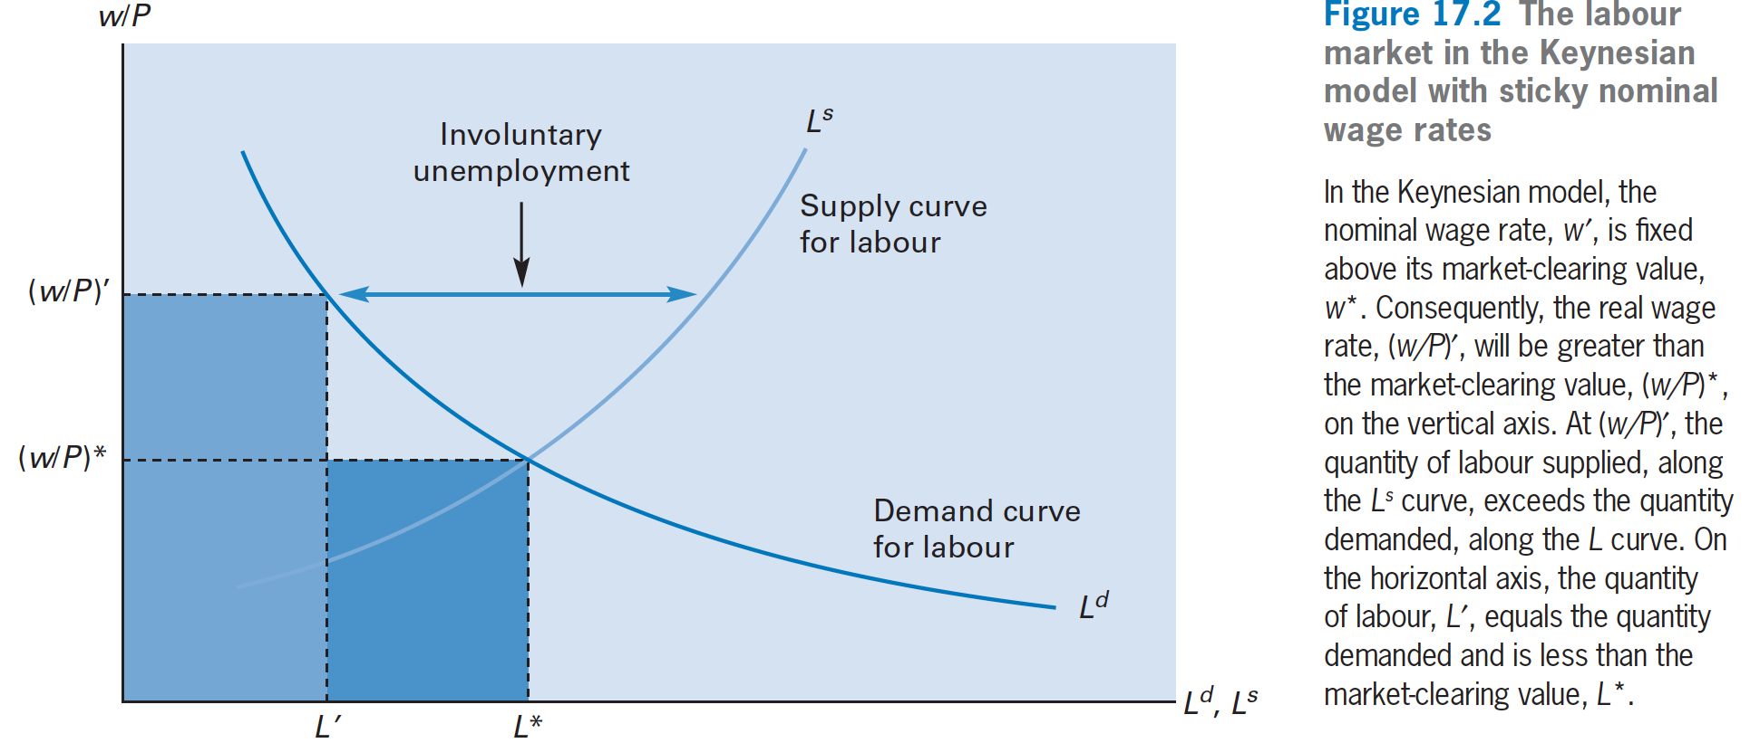
The Keynesian Model—
Sticky Nominal Wage Rates

Slide 38
The Keynesian Model—Sticky Nominal Wage Rates
We use the principle that L equals the smaller of the quantities demanded and supplied—in this case, the quantity demanded, L^{d}.
The excess of the quantity of labor supplied (at the given real wage rate, w/P) over L is called involuntary unemployment.

Slide 39
The Keynesian Model—Sticky Nominal Wage Rates
Suppose now, that a monetary expansion raises the price level, P. If the nominal wage rate, w, does not change, the rise in P lowers the real wage rate, w/P.
This fall in w/P raises the quantity of labor demanded, L^{d}, and, thereby, increases labor input on the horizontal axis from L’ to L”.
With sticky nominal wage rates, a monetary expansion raises labor input, L. The increase in L leads through the production function to an expansion of real GDP, Y.

Slide 40
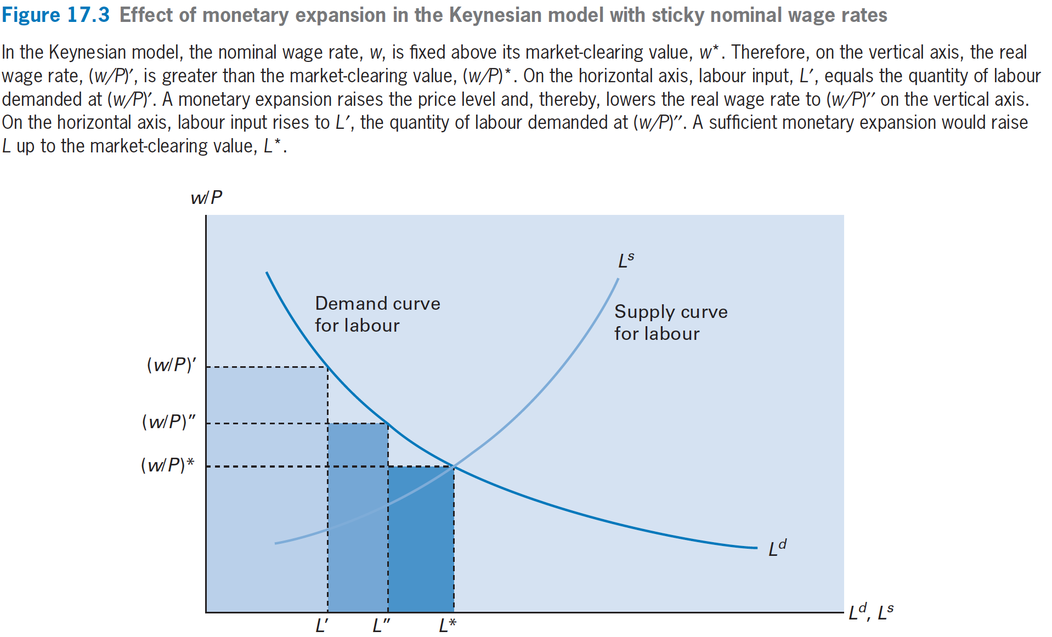
The Keynesian Model—Sticky Nominal Wage Rates

Slide 41
The Keynesian Model—Sticky Nominal Wage Rates
The Keynesian model is similar to the new Keynesian model in predicting that nominal money, M, and labor, L, would be pro-cyclical.
However, unlike the new Keynesian model, the Keynesian model predicts that w/P would be countercyclical—low when L and Y are high, and high when L and Y are low.
We have stressed that w/P typically moves in a pro-cyclical manner. Therefore, the Keynesian model has difficulty explaining the observed cyclical behavior of w/P.

Slide 42
Long-Term Contracts and
Sticky Nominal Wage Rates

Slide 43
Long-Term Contracts and
Sticky Nominal Wage Rates
For many workers, nominal wage rates are set for one or more years by the terms of agreements made with employers. These agreements are sometimes formal contracts between firms and labor unions.
More commonly, firms and workers have implicit contracts that specify in advance the nominal wage rate over some periods, often a fiscal or calendar year.

Slide 44
Long-Term Contracts and
Sticky Nominal Wage Rates
Suppose that an employer and employee agree on a fixed nominal wage rate, w, for the next year.
A natural choice is to set w equal to the best estimate of the average market-clearing nominal wage rate, w∗, that will prevail over the year.
Although the chosen w may be a rational expectation of w∗, unanticipated events lead to mistakes.

Slide 45
Long-Term Contracts and
Sticky Nominal Wage Rates
When the contract expires, the employer and employee agree on a new nominal wage rate, w, for the next year. This new w takes account of events during the current year, including the inflation rate, π.
Thus, if expectations are rational, mistakes in the setting of w for this year—due perhaps to underestimation of inflation—tend not to be repeated in the next year.

Slide 46
Long-Term Contracts and
Sticky Nominal Wage Rates
At any point in time, the economy has an array of existing labor contracts, each of which specifies a nominal wage rate, w, that likely deviates somewhat from the market clearing value, w∗.
Some of these agreements have w greater than w∗, and others less than w∗.

